Slide 1
Deep Generative Model
original tutorial

Slide 2
VAE HYL video

Slide 3
Pixel RNN

Slide 4
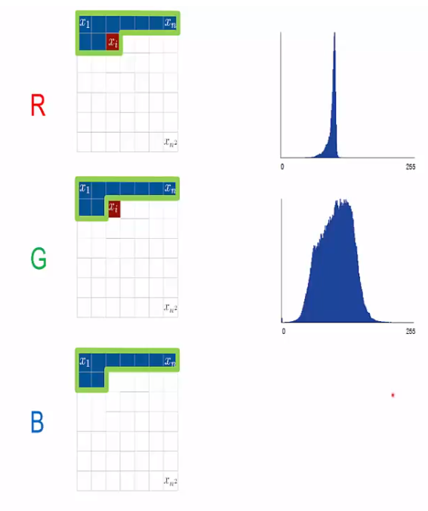
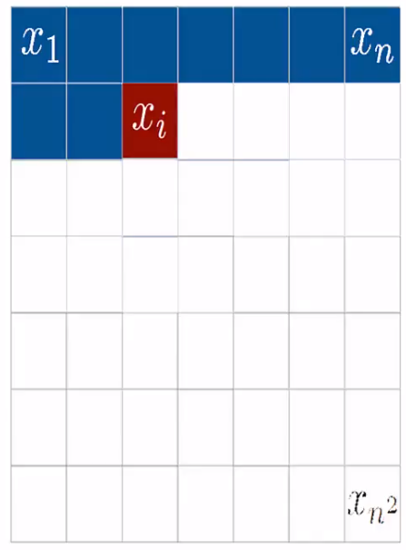
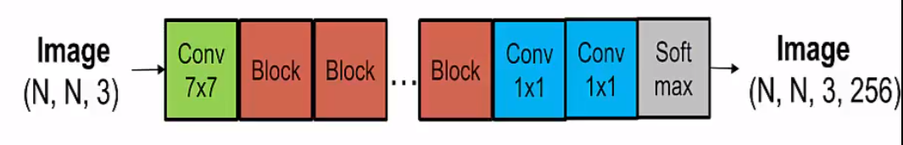
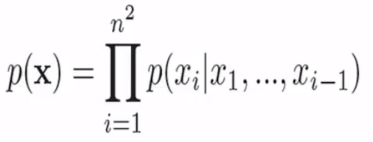
PixelRNN
sequence of pixels
dependent on previous pixels
Notes:
將pixel視為一序列的input sequence
從corner開始由左而右、由上而下預測每個pixel的顏色(0-255)
每個pixel都會受到先前predict過產出的pixel影響
最後由softmax(????)產出結果

Slide 5
Pixel CNN

Slide 6
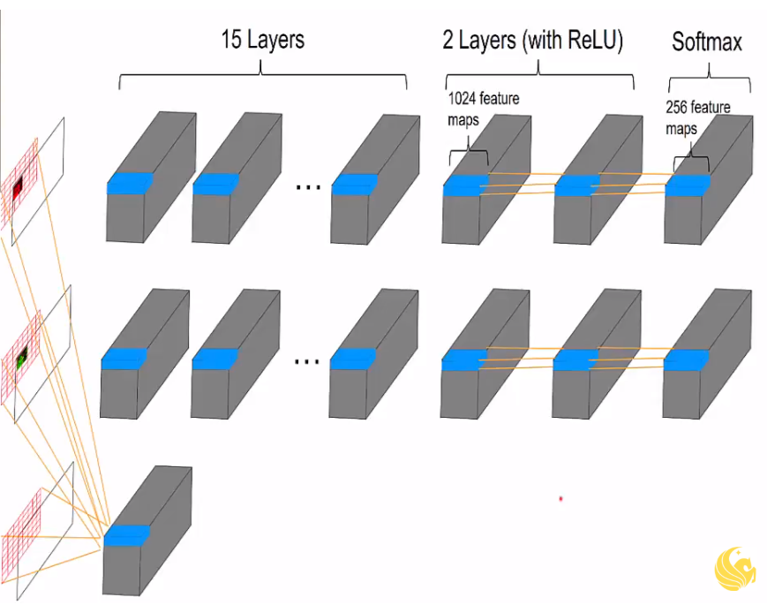
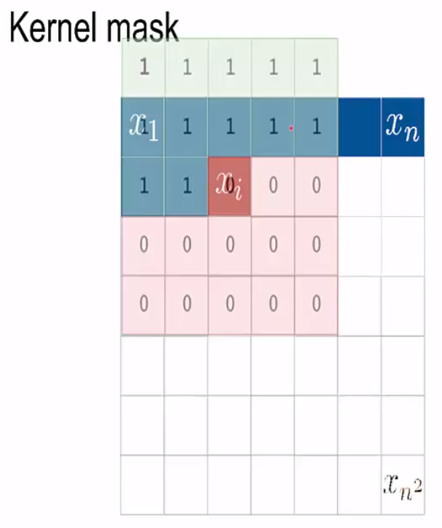
PixelCNN
Notes:
pixelCNN和pixelRNN概念類似
透過CNN的方式一次預測一個pixel的顏色(灰階或是RGB)
如果是RGB的話就是紅色、綠色、藍色依序
最後接softmax
kernel mask輔助每次要看那些pixel
缺點就是沒辦法看全局
https://www.youtube.com/watch?v=5WoItGTWV54
https://www.youtube.com/watch?v=-FFveGrG46w
ask: kernel mask的大小(用意) vs 看所有曾經生成的pixel

Slide 7
WaveNet

Slide 8
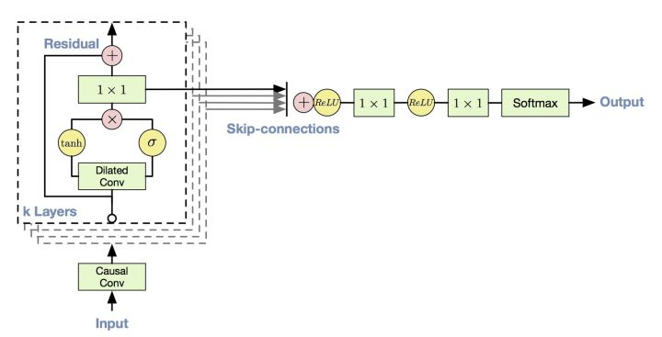
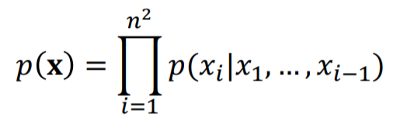
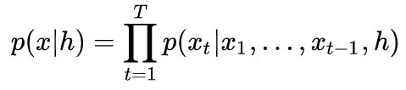
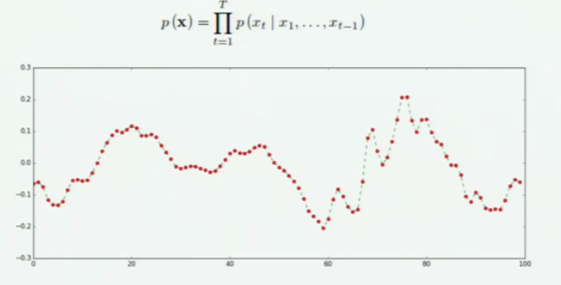
WaveNet
直接用聲音的原始波形來進行訓練，生成聲波訊號。 sigmoid 作為activation function 另外可以加入h作為conditional WaveNet
Notes:
wavenet是透過聲音訊號原始的波行當作input
基於先前的pixelCNN方法做訓練
sigmoid作為activation function
網路架構
condition 例如體育類、音樂類的聲音訊息
https://www.youtube.com/watch?v=FeJT8ejgsL0
裡面有pixelCNN,WaveNet,VAE的解說

Slide 9
Challenges for Graph Generation

Slide 10
Challenges for Graph Generation
• The structures and sizes of graphs are different
• No orders between the nodes
• Discrete
Notes:
圖的架構或是大小可能會很不一樣
圖中的節點是沒有順序性的，因此很難直接用sequences當作input來生成graph
graph上的node edge的attribute都是離散的性質，處理上比較困難

Slide 11
Graph VAE paper: arxiv 1802.03480 9 Feb 2018
Notes:
must predifined max size
requires Graph Matching

Slide 12
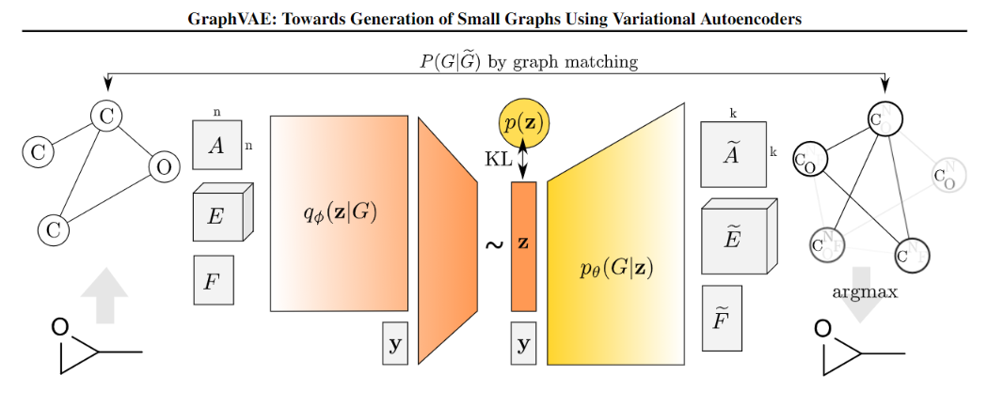
Graph VAE
input G=(A,E,F) n<=k nodes
adjacency matrix A
edge attribute tensor E
and node attribute matrix F
Notes:
CLASS PROBAILITIES 0~1 -> discrete

Slide 13
Graph VAE
VAE

Slide 14

Graph VAE
reconstruction loss
regularization
regularization
continuous embedding z
Notes:
KL是vae本來就有的 (normal distribution)
y?

Slide 15
Graph VAE
A~: predicted adjacency [node prob & edge prob]
E~: edge attribute, (class prob for edges)
F~: node attribute, (class prob for nodes)
sigmoid
softmax
softmax
probabilistic fully
connected graph (on k nodes)

Slide 16
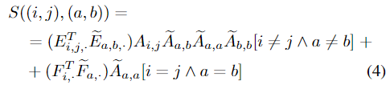
Graph VAE
similarity function
computation of likelihood P
Notes:
由similarity function得出X
similarity function中考量了edge pairs和node pairs的similarity
scores同時考量了feature compatibility(F,E) and existential compatibility(A)

Slide 17



Graph VAE
reconstruction loss
regularization
input adjacency matrix is mapped to the predicted graph
predicted node attribute matrix and slices of edge attribute matrix are transferred to the input graph as
The overall reconstruction loss is a weighed sum of the previous terms:
Notes:
X的定義
obtain from graph matching, a binary assignment matrix
只有0 or 1的選項

Slide 18
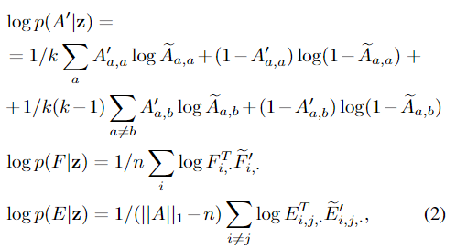
Graph VAE
obtain from graph matching, a binary assignment matrix
reconstruction loss
regularization
input adjacency matrix is mapped to the predicted graph
predicted node attribute matrix and slices of edge attribute matrix are transferred to the input graph as
The maximum likelihood estimates, i.e. cross-entropy, of respective variables are as follows:
The overall reconstruction loss is a weighed sum of the previous terms:
Notes:
X的定義 只有0 or 1的選項

Slide 19
JTVAE
paper: arxiv 1802.04364 29 Mar 2019

Slide 20
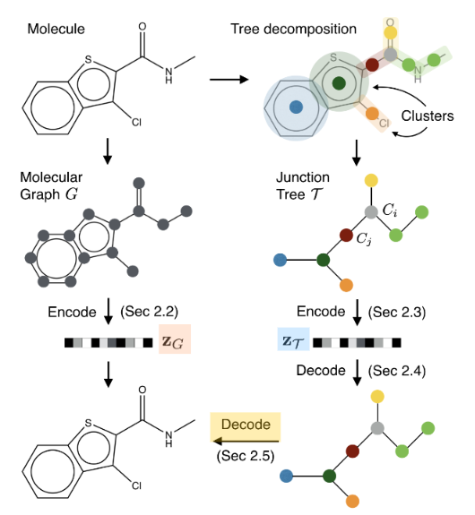
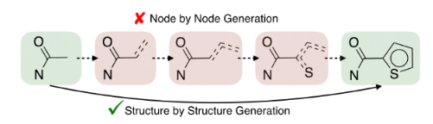
JTVAE
Structure by structure approach is preferred as it avoids invalid intermediate states (marked in red) encountered in node by node approach.
latent embeddings

Slide 21
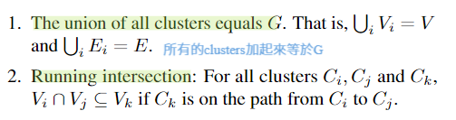
JTVAE - Junction Tree
A tree decomposition maps a graph G into a junction tree by contracting certain vertices into a single node so that G becomes cycle-free.
Notes:
2.???

Slide 22


JTVAE - Graph Encoder
Notes:
U????

Slide 23


JTVAE - Tree Encoder
After the message passing, we obtain the latent representation of each node hi by aggregating its inward messages:

Slide 24



JTVAE - Tree Decoder
topological prediction:
new child’s label prediction:
distribution over label vocabulary X.
Let p and q be the ground truth topological and label values, the decoder minimizes the following cross entropy loss:
Notes:
The tree is constructed in a top-down fashion by generating one node at a time.
traverses the entire tree from the root, and generates nodes in their depth-first order
For every visited node, the decoder first makes a topological prediction: whether this node has children to be generated.
When a new child node is created, we predict its label and recurse this process.
Similar to sequence generation, during training we perform teacher forcing: after topological and label prediction at each step, we replace them with their ground truth so that the model makes predictions given correct histories.

Slide 25
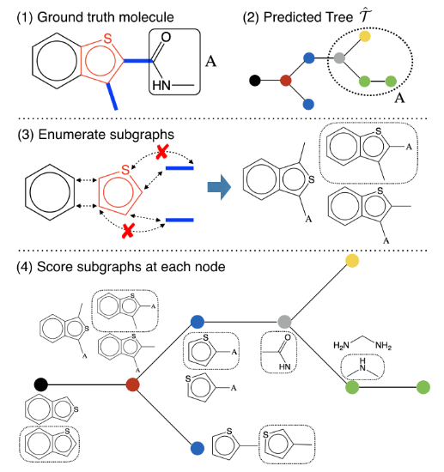
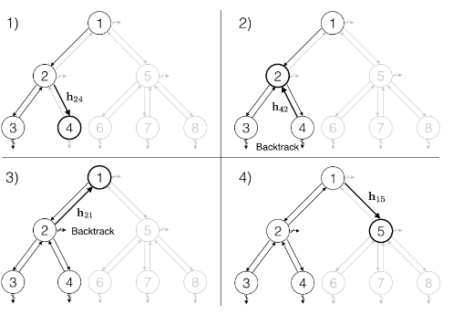
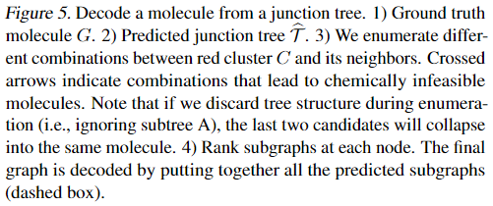
JTVAE - Tree Decoder
Rank subgraphs at each node. The final graph is decoded by putting together all the predicted subgraphs (dashed box).
Notes:
The tree is constructed in a top-down fashion by generating one node at a time.
traverses the entire tree from the root, and generates nodes in their depth-first order
For every visited node, the decoder first makes a topological prediction: whether this node has children to be generated.
When a new child node is created, we predict its label and recurse this process.

Slide 26
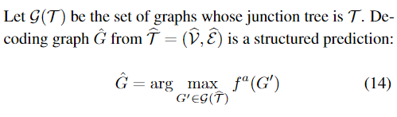
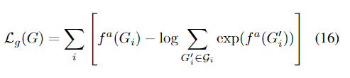
JTVAE - Graph Decoder
scoring function
maximize the log-likelihood of predicting correct subgraphs Gi of the ground true graph G at each tree node. We again apply teacher forcing, i.e. we feed the graph decoder with ground truth trees as input.
Notes:
不同分子可能共享同一個junction tree(junction tree長一樣)
目標: assemble the subgraphs (nodes in the tree) together into the correct molecular graph.
右圖:因為clusters結合的方式不同

Slide 27
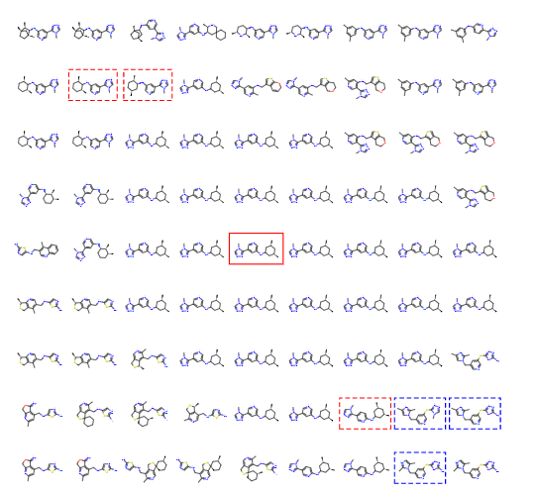
JTVAE - Graph Decoder
same tree structure
but different moleculars
Notes:
不同分子可能共享同一個junction tree(junction tree長一樣)
目標: assemble the subgraphs (nodes in the tree) together into the correct molecular graph.
右圖:因為clusters結合的方式不同

Slide 28
JTVAE - Junction Tree
A tree decomposition maps a graph G into a junction tree by contracting certain vertices into a single node so that G becomes cycle-free.
Notes:
2.???

Slide 29
JTVAE - Graph Encoder
message passing through edges
compute the messages of latent vector of each node
Notes:
U????

Slide 30
JTVAE - Tree Encoder
top-down,bottom up
GRU over tree nodes
After the message passing, we obtain the latent representation of each node hi by aggregating its inward messages:

Slide 31
JTVAE - Tree Decoder
topological prediction:
new child’s label prediction:
Let p and q be the ground truth topological and label values, the decoder minimizes the following cross entropy loss:
Notes:
The tree is constructed in a top-down fashion by generating one node at a time.
traverses the entire tree from the root, and generates nodes in their depth-first order
For every visited node, the decoder first makes a topological prediction: whether this node has children to be generated.
When a new child node is created, we predict its label and recurse this process.
Similar to sequence generation, during training we perform teacher forcing: after topological and label prediction at each step, we replace them with their ground truth so that the model makes predictions given correct histories.

Slide 32
JTVAE - Graph Decoder
scoring function
maximize the log-likelihood of predicting correct subgraphs Gi of the ground true graph G at each tree node. We again apply teacher forcing, i.e. we feed the graph decoder with ground truth trees as input.
Notes:
不同分子可能共享同一個junction tree(junction tree長一樣)
目標: assemble the subgraphs (nodes in the tree) together into the correct molecular graph.
右圖:因為clusters結合的方式不同
z: junction tree encoding
h:latent representation of each node

Slide 33
JTVAE - Graph Decoder
same tree structure
but different moleculars
Notes:
不同分子可能共享同一個junction tree(junction tree長一樣)
目標: assemble the subgraphs (nodes in the tree) together into the correct molecular graph.
右圖:因為clusters結合的方式不同

Slide 34
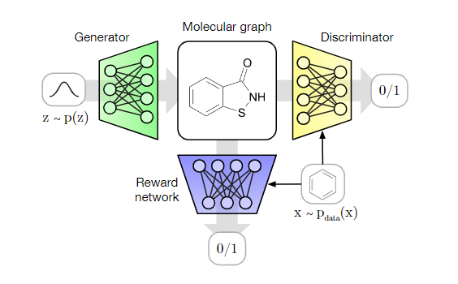
MolGAN paper: arxiv 1805.11973 30 May 2018
Notes:
max size should be predifined

Slide 35
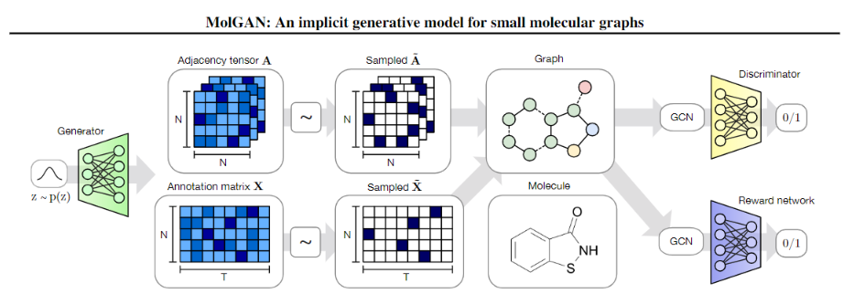
MolGAN
improved WGAN
improved WGAN
implicit, likelihood-free.
using RL for desired properties.
Notes:
class probability vs categorical sampling
one-hot

Slide 36

MolGAN - Generator
loss
Notes:
Both X and A have a probabilistic interpretation since each node and edge type is represented with probabilities of categorical distributions over types
trade-off

Slide 37


MolGAN - Generator
bond types
categorical sampling
categorical sampling
atom types
Generator: predicts the entire graph at once using a simple multi-layer perceptron (MLP). While this limits our study to graphs of a pre-chosen maximum size, we find that it is significantly faster and easier to optimize.
Notes:
Both X and A have a probabilistic interpretation since each node and edge type is represented with probabilities of categorical distributions over types

Slide 38
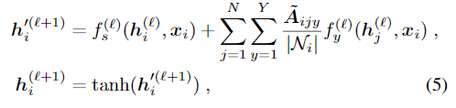
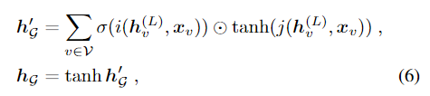
MolGAN - Discriminator & Reward Network
Relational - GCN
support for
multiple edge types
Notes:
(e.g., how likely the generated molecule is to be soluble in water) 水中溶解性多大，無效分子就給0分
We base our model on Relational-GCN (Schlichtkrull et al., 2017), a convolutional network for graphs with support for multiple edge types. At every layer, feature representations of nodes are convolved/propagated according to:

Slide 39
MolGAN - Discriminator & Reward Network
Relational - GCN
support for
multiple edge types
Notes:
(e.g., how likely the generated molecule is to be soluble in water) 水中溶解性多大，無效分子就給0分
We base our model on Relational-GCN (Schlichtkrull et al., 2017), a convolutional network for graphs with support for multiple edge types. At every layer, feature representations of nodes are convolved/propagated according to:

Slide 40

MolGAN - Discriminator & Reward Network
input: graph
output:scalar value
0 or 1
same architecture
but no parameter sharing
Discriminator: samples from the dataset and the generator -> learns to distinguish them
Reward Network: dataset and generated samples are inputs -> assigns scores to them (using RDKit)
Notes:
(e.g., how likely the generated molecule is to be soluble in water) 水中溶解性多大，無效分子就給0分
We base our model on Relational-GCN (Schlichtkrull et al., 2017), a convolutional network for graphs with support for multiple edge types. At every layer, feature representations of nodes are convolved/propagated according to:

Slide 41
GCPN paper 2018

Slide 42
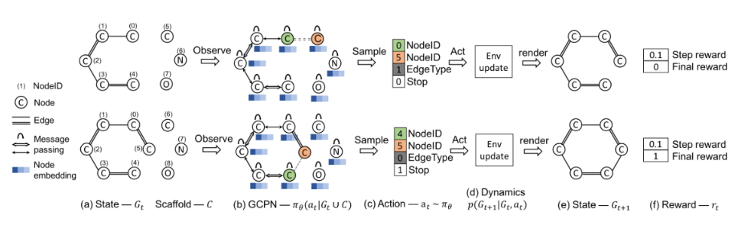
GCPN

Slide 43
GCPN - Markov Decision Process

Slide 44
GCPN - State Space & Action Space
G
C
State space: 初始值給定一個碳元素node
Action space: 視作link prediction
Connect a new subgraph Ci to a node in Gt or
connecting existing nodes within graph Gt

Slide 45
GCPN - State Transition Dynamics
State Transition Dynamics: 考量Domain-specific rules，step-wise valency check in incompleted graph
obey the given rules or
be rejected and the state remains unchanged
Notes:
state remains unchanged: 如果不符合rule和valency check的話就取消剛剛做的action 然後state保持原樣 並記錄一個負的step-wise validity rewards (step reward)

Slide 46
GCPN - Reward Design
Reward Design:
intermediate rewards:
step-wise validity rewards and adversarial rewards
final rewards
a sum over domain-specific rewards and adversarial rewards
Notes:
domain rewards:The domain-specific rewards consist of the (combination of) final property scores, such as octanol-water partition coefficient辛醇 - 水分配係數 (logP), druglikeness 類藥性(QED) [1] and molecular weight分子量 (MW).
Domain-specific rewards also include penalization of unrealistic molecules according to various criteria, such as excessive steric strain and the presence of functional groups that violate ZINC functional group filters [14]
intermediate:A small positive reward is assigned if the action does not violate valency rules, otherwise a small negative reward is assigned.

Slide 47
GCPN - Reward Design
Reward Design: the adversarial rewards
Notes:
discriminator(from pdata) 和 policy算出來的 架構跟policy一樣但不在這張圖上
domain rewards:The domain-specific rewards consist of the (combination of) final property scores, such as octanol-water partition coefficient (logP), druglikeness (QED) [1] and molecular weight (MW). Domain-specific rewards also include penalization of unrealistic molecules according to various criteria, such as excessive steric strain and the presence of functional groups that violate ZINC functional group filters [14]
intermediate:A small positive reward is assigned if the action does not violate valency rules, otherwise a small negative reward is assigned.

Slide 48
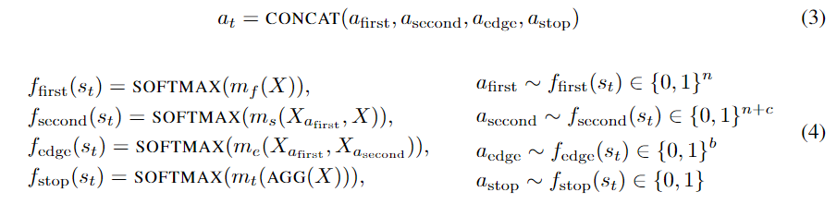
GCPN - Graph Convolutional Policy Network
computing node embeddings using GCN
action prediction
Notes:
m as MLP the final node embedding matrix X (from GCN)

Slide 49
GCPN - Policy Gradient Training
Proximal Policy Optimization (PPO) & objective function during pretraining (supervised)
where (st;at) pairs are obtained from ground truth molecules.
Notes:
expert:從現有的有效分子dataset學習
會把dataset裡面的分子拆成各個連接步驟(action)用這樣的state action pairs去做訓練，訓練時的objective function便是下面那行

Slide 50
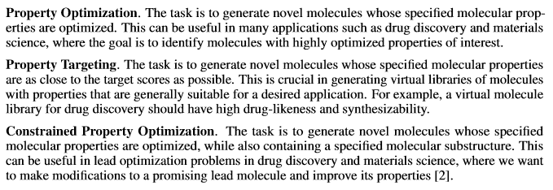
GCPN - Experiments
specified properties are optimized
properties are as close to the target score
specified properties are optimized,
and also containing specified substructure
Notes:
1.
2.這個task下的RL的reward是與生成target的差距
3.優化logP，同時要求生成的分子包含一個帶有low logP的ZINC分子，這個task下，初始狀態從隨機的一個ZINC 分子出發，然後對logP進行優化
https://zhuanlan.zhihu.com/p/70134702

Slide 51
GCPN[98]利用RL生成目標導向的分子圖，以處理不可導目標和約束。實驗結果證明了GCPN在各種圖生成問題中的有效性。
MolGAN[99]也採用了類似的思想，即使用RL生成分子圖。MolGAN建議直接生成完整的圖，而不是通過一系列的動作來生成圖，這對小分子很有效。
Notes:
https://zhuanlan.zhihu.com/p/54369820

